Slide 1
Create a mind map about Computational Thinking covering the 4 stages:
Use bullet points to briefly describe what happens at each stage
HELP: Use the links to help you (Ctrl + click)
https://en.wikibooks.org/wiki/A-level_Computing/AQA/Problem_Solving,_Programming,_Data_Representation_and_Practical_Exercise/Problem_Solving/Introduction_to_principles_of_computation
https://www.bbc.co.uk/bitesize/guides/zp92mp3/revision/1
The application of the thinking skills involved in analysing problems and processes, to identify solutions
that can be developed into computer programs
What is it?
A4 Algorithm Design
A1 Decomposition
Computational Thinking
Designing pseudocode, flowcharts and algorithms for scenarios.
Making step by step solutions for a problem.
Decomposition breaking data down into smaller pieces
A3 Pattern Generalisation and Abstraction
A2 Pattern Recognition
Removing unnecessary data and focuses on the important parts.
Recognises patterns that repeat more than once in a sequence of data.

Slide 2
Groups
Groups
Group 1 | Lauren (B1800342) Saram (B1904340)
Group 2 | Harry (B1801411) Joel (B1901688) Abdul (B1904336)
Group 3 | Josh (B1900738) Jan (B1904054) Damian (B1901505)
Group 4 | Jacob (B1901279) Simon (B1904298)
Group 5 | Evan (B1800387) Husnain (B1905311)
Group 6 | Jay (B1902354) John (B1901412) Kye (B1902610)

Slide 3
Solving a problem using Computational Thinking
You have been asked to create an electronic version of the game 15 (Player vs Computer) using the principles of Computational Thinking
Game Rules: 15
Two player
The aim of the game is to pick 3 numbers that add up to 15
Players should take it in turns to pick a number between 1 and 9. Each number can only be used once and by one player only
Before you can apply the principles of Computational Thinking you must have a good understanding of the problem:
Task 1 – Play the game

Slide 4
Apply the principles of Computational Thinking to the game 15
1 Decomposition | 2 Pattern Recognition
Game setup Players takes turn Check if one player won. | Like noughts and crosses
3 Generalisation/Abstraction | 4 Algorithm Design
Store input (numbers) Store grid | Plan algorithms using pseudocode/flowcharts However on this occasion you are going to program the game using c# (In Your Groups) Use CamStudio to video your solution and save it in the hand in folder: IT → Hand in → BTEC Computing → 2019-21

Slide 5

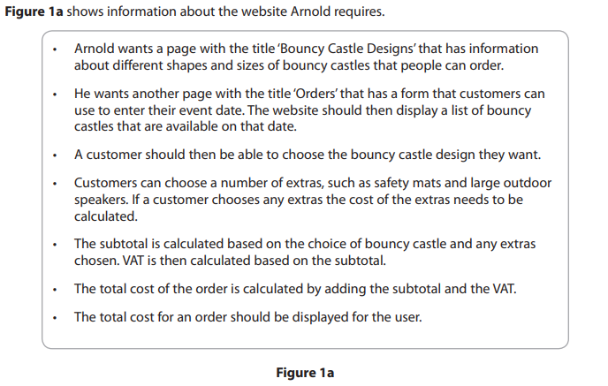
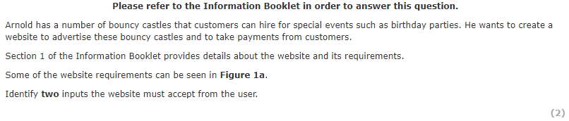
Exam Questions
[2]
Bouncy castle design Number of extras

Slide 6
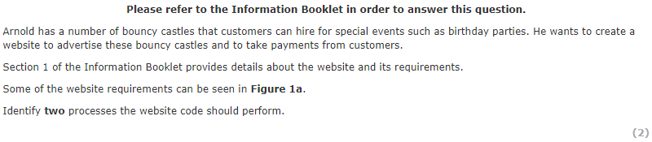
Exam Questions
[2]
Calculate subtotal Calculate VAT

Slide 7

Exam Questions
[3]
Get rid of unnecessary parts. Makes the problem easier to solve in smaller increments, as it is clearly shown in defined steps. Describe the problem easily, make it more manageable.

Slide 8
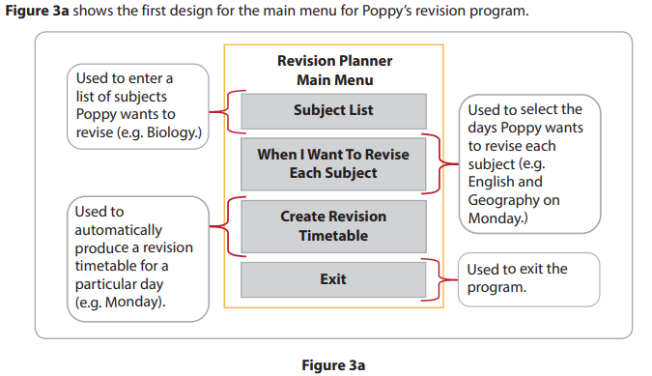
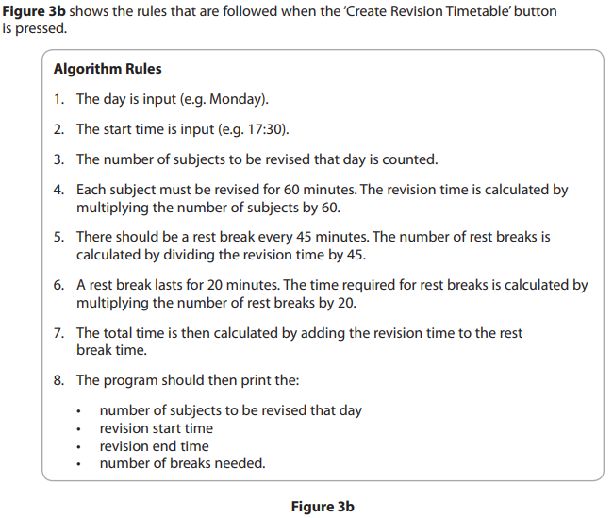
Exam Questions

Slide 9
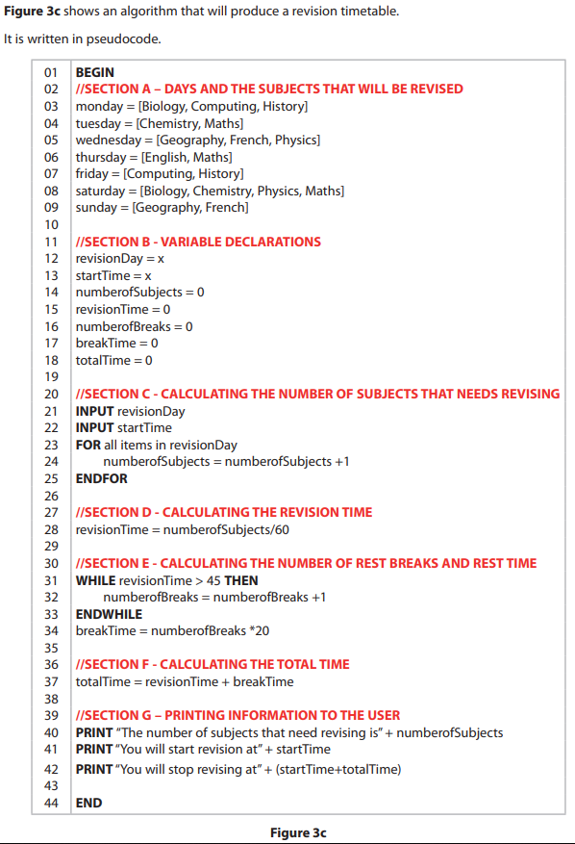
Exam Questions

Slide 10
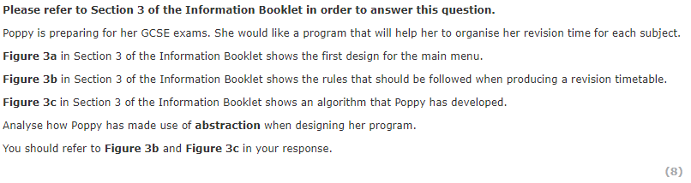
Exam Questions
[8]
In figure 3b she has removed all of the non-necessary information and only left the vital steps that must be followed to get the desired result. She has identified the general themes such as Subjects, Days, Time. In figure 3c she has written an algorithm in pseudocode

Slide 11
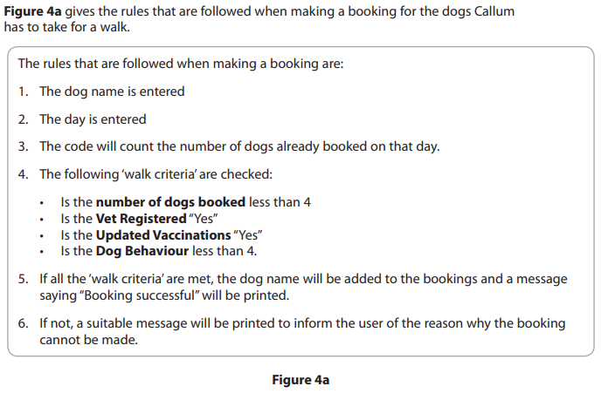
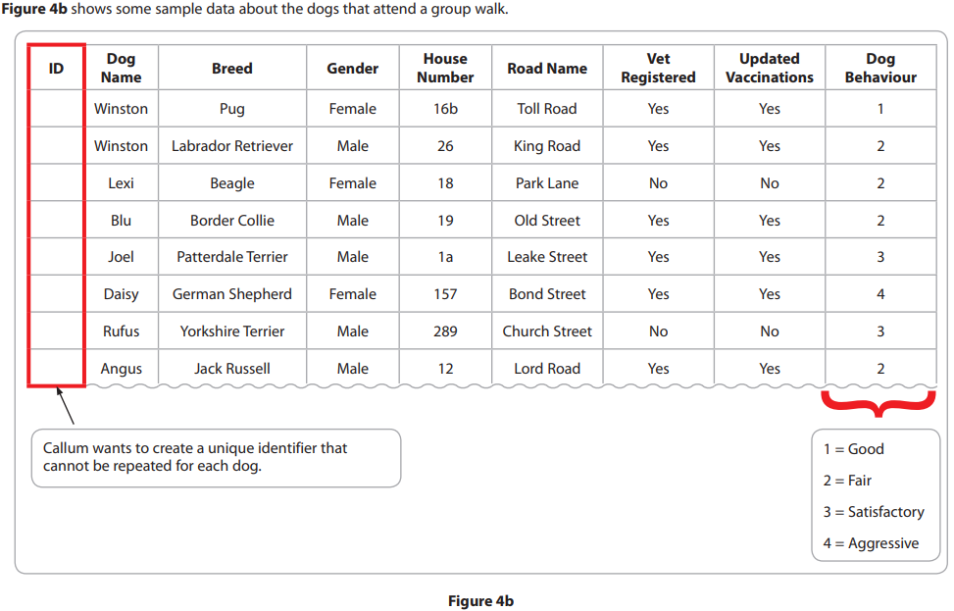
Exam Questions

Slide 12
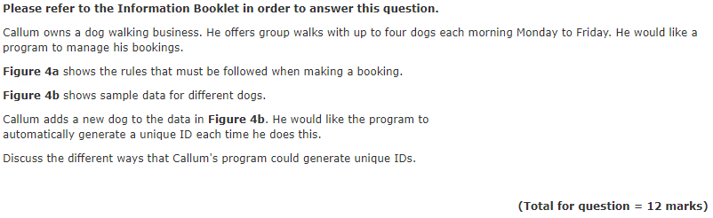
Exam Questions
[12]
Callum could concatenate time and date in a string, this is simple but may cause problems and lead to errors as it could create a long ID. He could use count occurrences search that will count the number of dogs / records / line that are currently stored.

